Slide 1
Human Eye
Fall 2011
Dr Naveed Iqbal
http://media.cs.tsinghua.edu.cn/~naveed
naveedi@mail.mcs.edu.pk

Slide 2
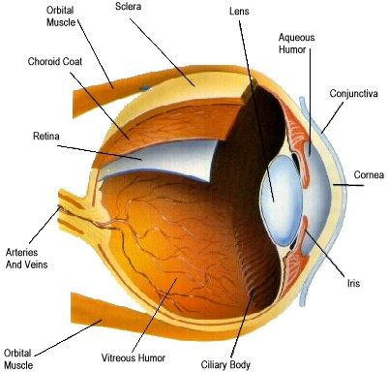
Human Eye - Structure
Three Layers:
Cornea and Sclera: Opaque, Tough Tissues
Choroid: Have blood vessels, Heavily Pigmented. It has two parts, Ciliary Body and Iris Diaphram
Retina

Slide 3
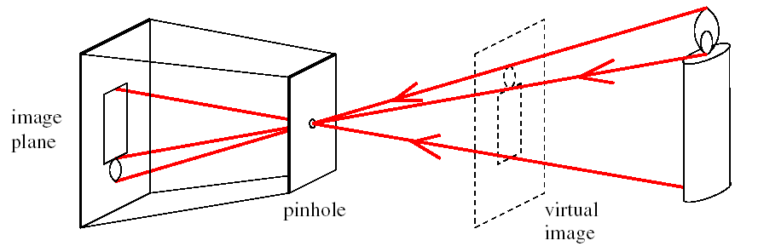
Image Formation Principle

Slide 4
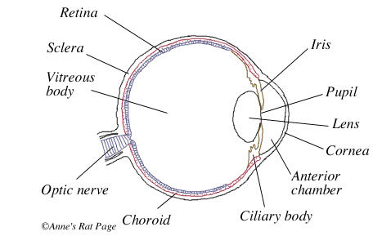
Human Eye Structure
Three Layers:
Cornea and Sclera: Opaque, Tough Tissues
Choroid: Have blood vessels, Heavily Pigmented. It has two parts, Ciliary Body and Iris Diaphram
Retina

Slide 5
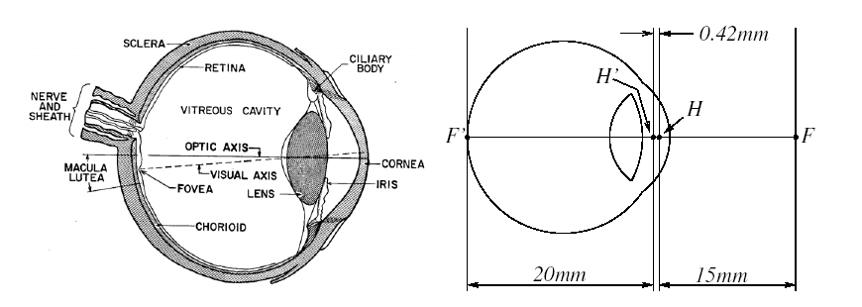
Human Eye

Slide 6
Visual Receptors
Retina
  Cones (photopic or bright-light vision)
    6-7 million cones
      one per nerve
      high resolution
    Located in fovea (central portion)
    Sensitive to color
  Rods (scotopic or dim-light vision)
    75-150 million rods
      several per nerve
      low resolution
  Blind spot ~17º off axis

Slide 7
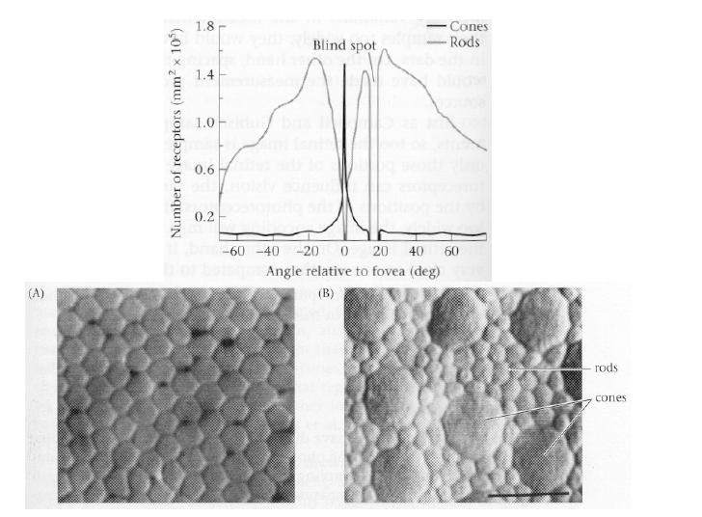

Slide 8
Fovea as a square sensor array of size 1.5mmx 1.5mm
Density of cones is about 150,000 elements per mm square
Cones are 337,000 elements
In Charge Coupled Devices can achieve it in 5 mm x 5 mm

Slide 9
References
[1] Prof Guangyou Xu, Tsinghua University, Beijing, China
[2] CVPR 07

